Slide 1

23W_CST2105_300: Data Science Foundations for BISI Final Project: Sales Prediction
Presented by:
Happiness NDUBISI
AIKHOJE IKHUOSO
Gabriel NTOWENG

Slide 2
OUTLINE
1. Business understanding
2. Data understanding
3. Data preparation
4. Modeling and pipeline creation
5. Model evaluation and selection
6. Conclusion

Slide 3
1. Business understanding
Walmart is an American multinational retail corporation and the word largest retailer, has been in existence since 1962.
Over the years, Walmart has built a strong and influencing brand known for its low prices, wide selection of product and their commitment to customers.
Walmart business model is based on providing values to its customer through cost savings and efficiency.

Slide 4
Problem statement
Sales is a crucial part of every business and a major determinant of business growth.
Inaccurate forecast of Walmart sales can lead to over stocking or stock out, inaccurate calculation of revenue and affect investment decision.
Accurate sales prediction can give Walmart an idea of future sales expectation and how projected targets can be achieve as not reaching target could negatively affect stock prices and will be a problem for Walmart.

Slide 5
Objectives
Build a model to predict weekly sales
Be able to make better future plans
Limit the problem of overstocking and understocking
Achieve projected targets
Decide on the best investment

Slide 6
2. Data understanding
Data capture and explanations
Store: The different store represented numerical values between 1 – 45
Type: Store type represented with A, B and C
Dept: Department in the store represented in numerical values
MarkDown: There are 5 markdown which represent the promotional sales
IsHoliday: Stare when there is holidays it is represented with true meaning there is holiday and false no holiday
Unemployment: represented in float
Temperature: Measured in Celsius
CPI: Consumers price index represented in float
Weekly_Sales: department weekly sales represented in dollars

Slide 7
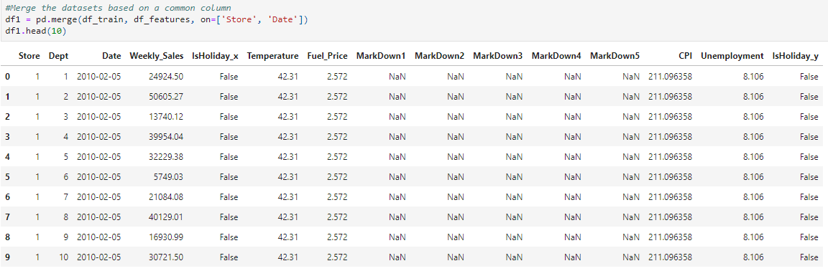
2. Data understanding
Data explorations (train and features)

Slide 8
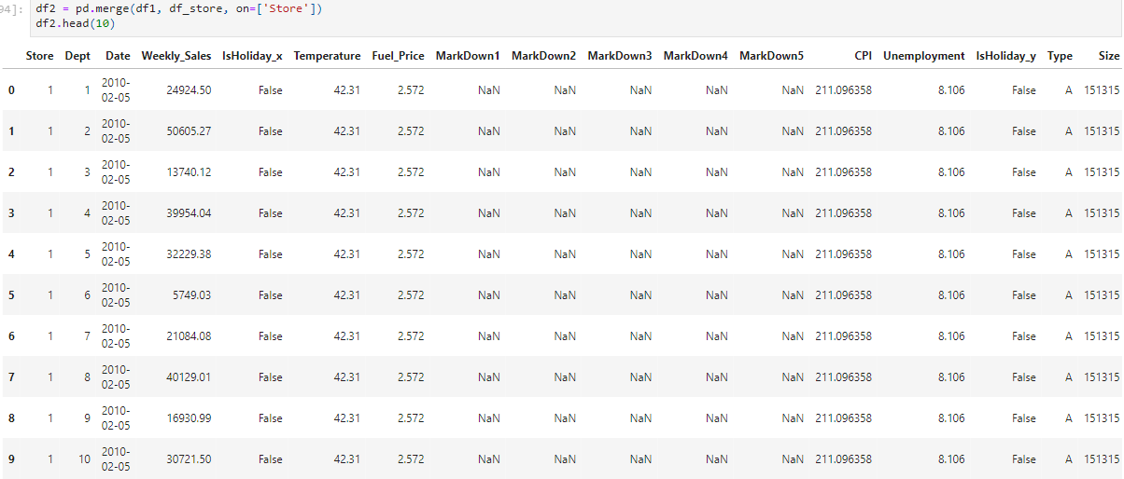
2. Data understanding
Data explorations (df1 and store)

Slide 9
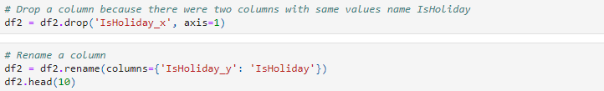
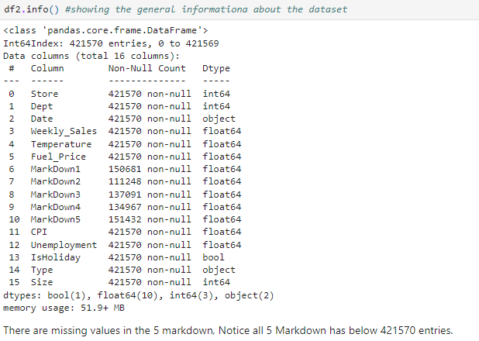
2. Data understanding
Data explorations

Slide 10
3. Data preparation
Data as combination of 4 CSV files (Store data, features, target, test)
Data imported to Jupyter notebook
EDA (dropped duplicated columns, renamed features)
Feature engineering (label encoding for store type)
Store A, B, C into 1, 2, 3

Slide 11
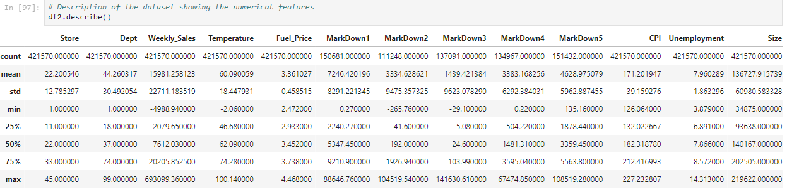


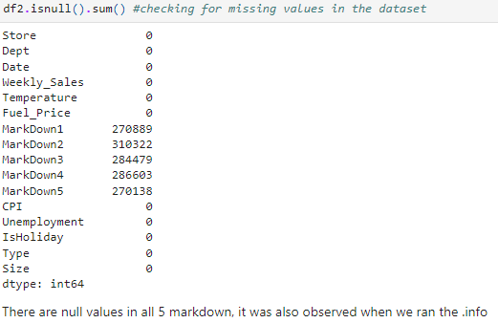
3. Data preparation
EDA

Slide 12
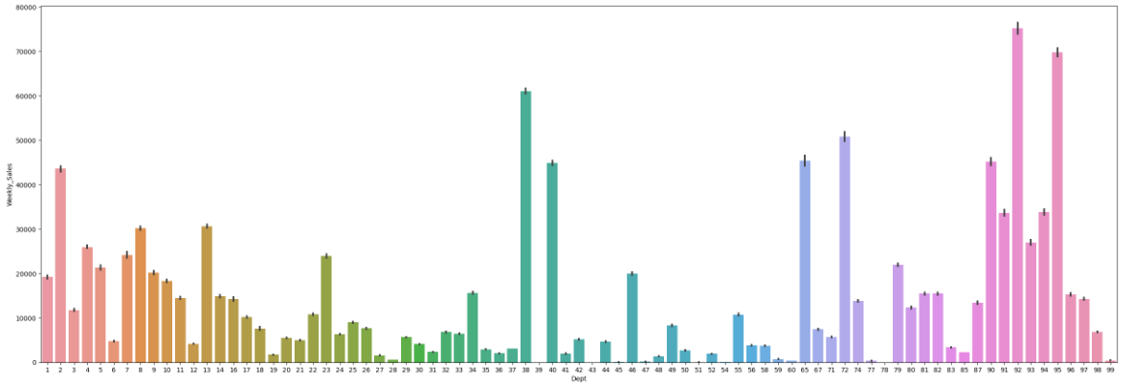
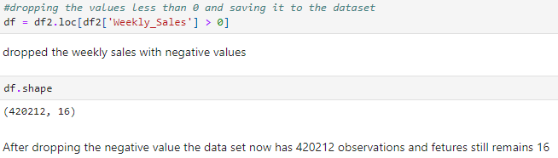
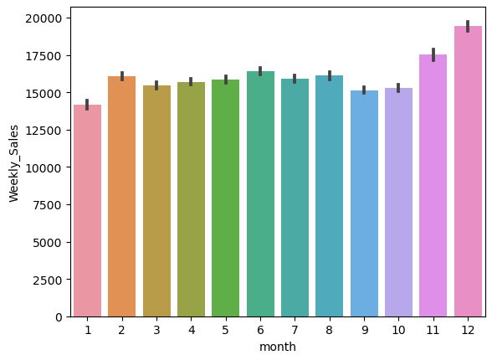
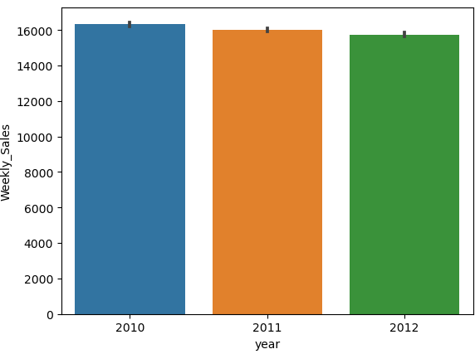
3. Data preparation
EDA (next)

Slide 13
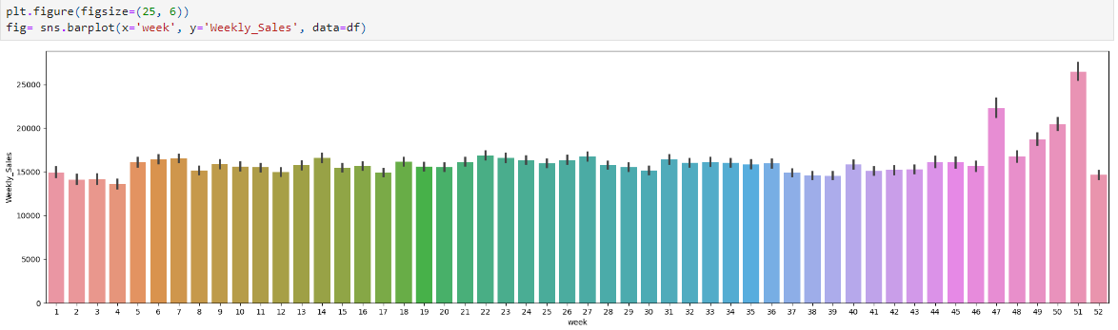
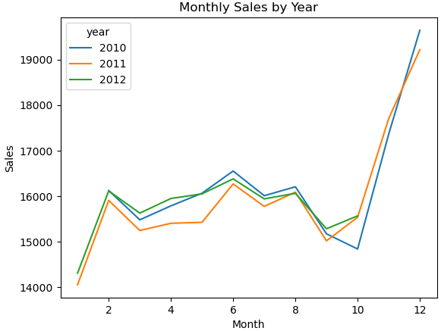
3. Data preparation
EDA (next)

Slide 14
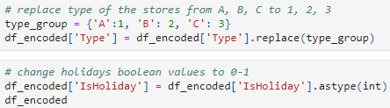
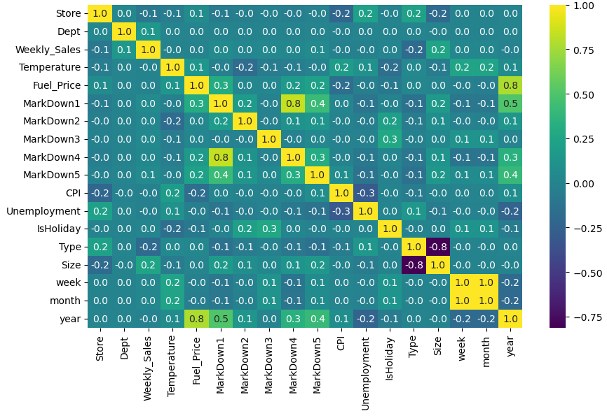
3. Data preparation
Feature engineering – Encoding the data

Slide 15
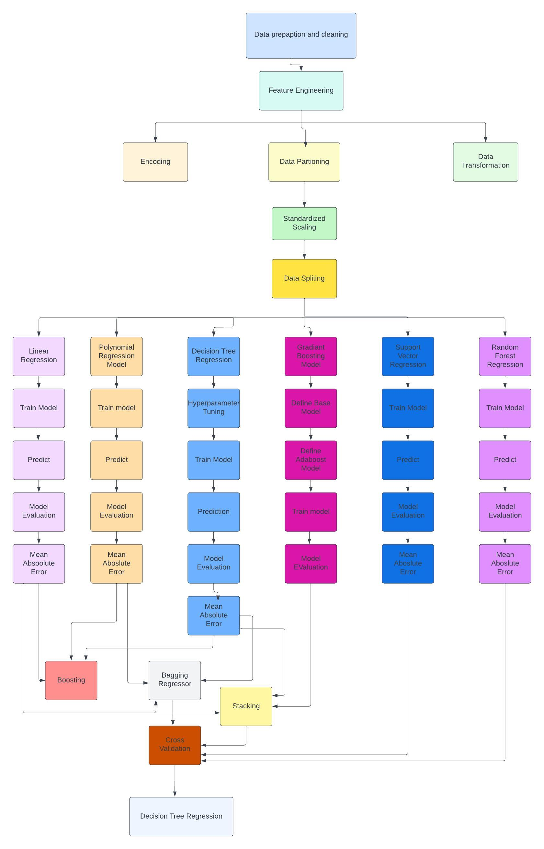
4. Modeling and pipeline creation

Slide 16
5. Model evaluation and selection
MODELS | MEAN ABSOLUTE ERROR
Linear Regression | 14597.43
Decision Tree | 11442.33
Polynomial Regression Model | 12871.58
Gradient Boosting | 7017.33
Boosting Decision Tree Regressor Linear Regression Polynomial Features | 14482.025
Bagging using Decision Tree Regressor Linear Regression Polynomial Features | 8901.99
Stacking using Decision TreeRegressor, Linear Regression Polynomial Features | 6641.67
SVM | 12871.58
Random Forest | 12871.58

Slide 17
5. Model evaluation and selection
CROSS VALIDATION
MODELS | MEAN ABSOLUTE ERROR
Linear Regression | 21719.46
Decision Tree | 42.55
Random Forest | 1414.39
Support Vector Regression | 1414.4
Gradient Boosting | 7952.32

Slide 18
6. Conclusion
Walmart should stock up to avoid understocking (week 51 had higher sales compared to the other weeks, and that is as a result of Christmas and new year celebration)
Decision Tree algorithm should be used in predicting Walmart weekly sales

